Slide 1

Sustainability as a Business Issue in product manufacturing
Webinar, 22 November 2023
Jane Thornback
Sustainability Policy Advisor

Slide 2
Structure of my Presentation
          Construction Products Association
          Sustainability - what’s the issue / why the concern
          Sustainability - not a new concept
          Sustainability - many interpretations
          Key Themes for construction product manufacturers
          My role at CPA / CPA Sustainability Group / current Priorities
          What are you doing / Are you doing enough?
          Q&A
          I will limit my boundary to environmental sustainability

Slide 3
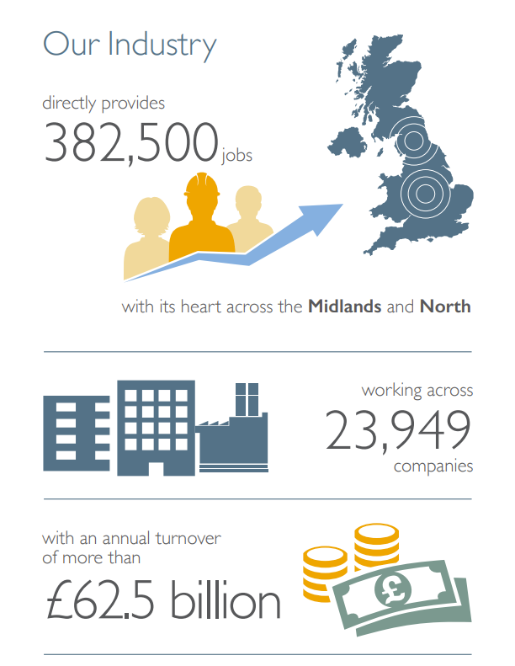
Construction Products Association
http://www.constructionproducts.org.uk/

Slide 4
          Umbrella body for UK-based manufacturers (but many European or global); many SMEs
          CPA is material and product neutral, so do not promote specific sectors or companies
          25 large company members + 41 trade associations
          Huge variation in what they make:
              Materials – ceramics, timber, concrete, steel, plastics, steel
              Products from materials - windows, flooring, roof tiles, doors, adhesives and sealants, coatings, insulation, flooring
Size of industry – £62 billion / 24,000 companies
Over 70% of construction products used in the UK are manufactured in the UK; raw materials may of course be from elsewhere

Slide 5

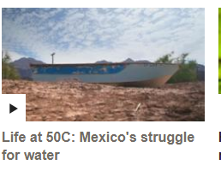


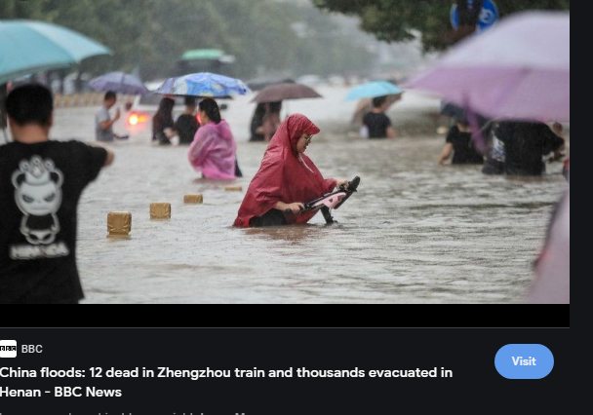
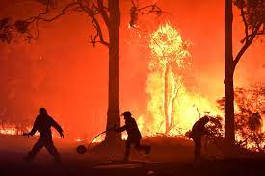
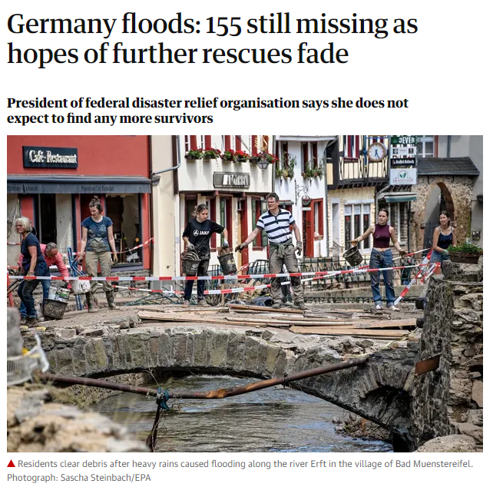
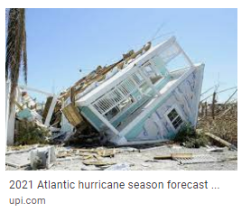
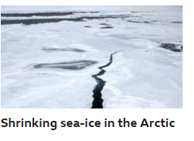
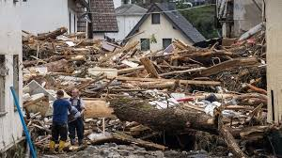
Systems Changing
Temperature records
Droughts
Australia fires
Hurricanes 2021
China floods 2021
Sea Ice melting
Germany floods 2021

Slide 6
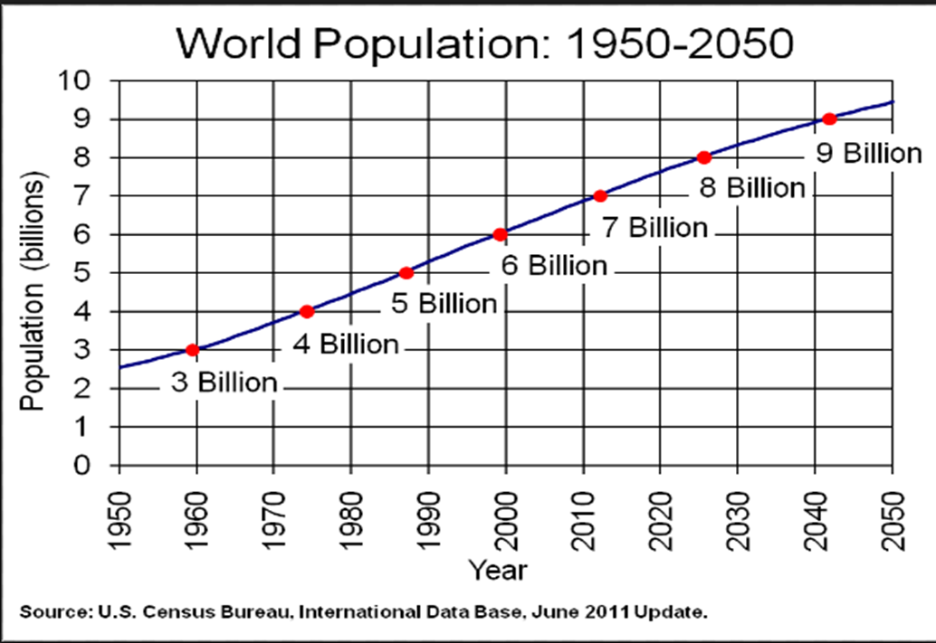
Drivers of System Change
Consumption and Production

Slide 7

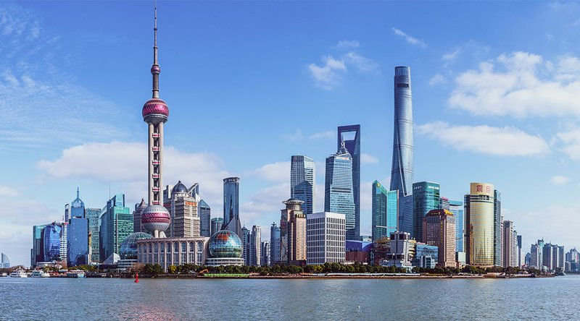
Shanghai 1987
Using lots more resources
Shanghai 2023

Slide 8
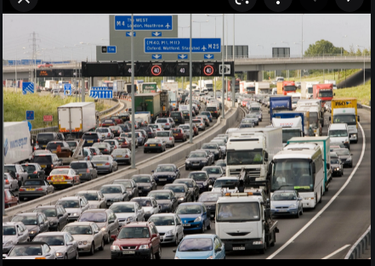
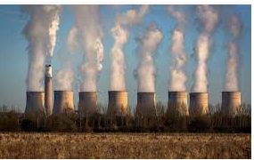
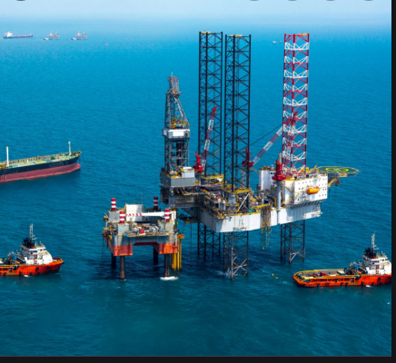
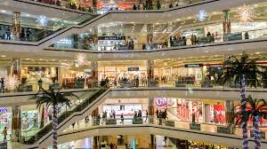
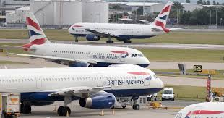
Modern living dependent on high carbon lifestyles

Slide 9




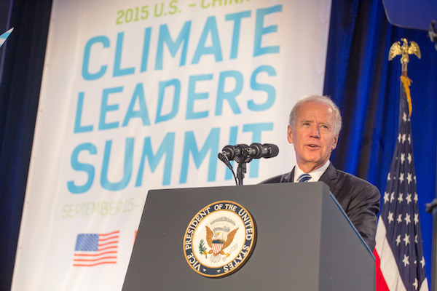

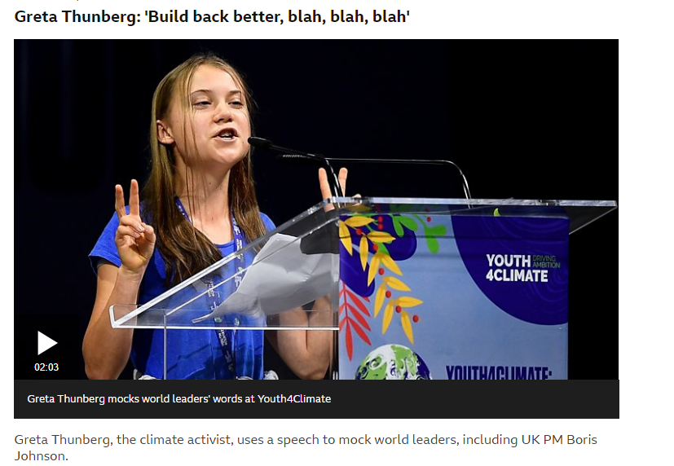
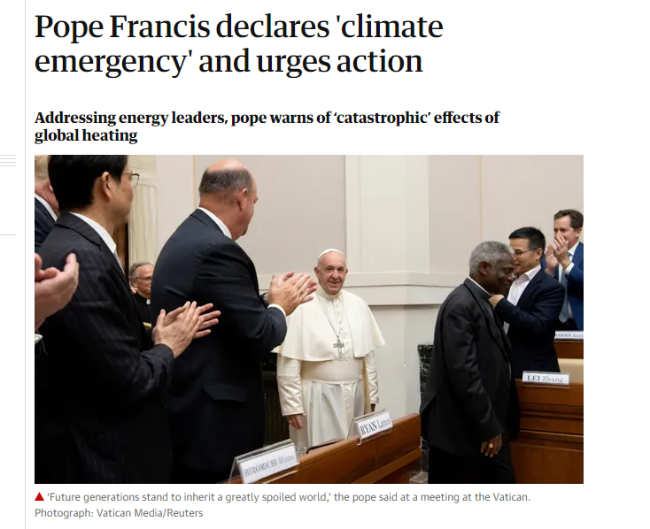
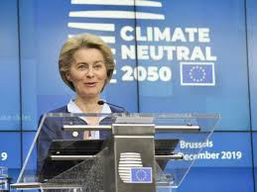
Alarm and Response

Slide 10

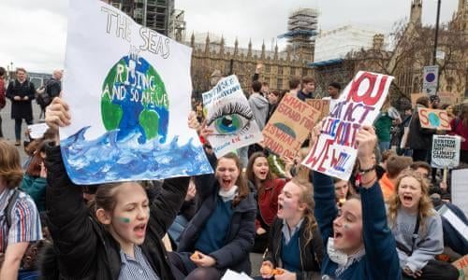
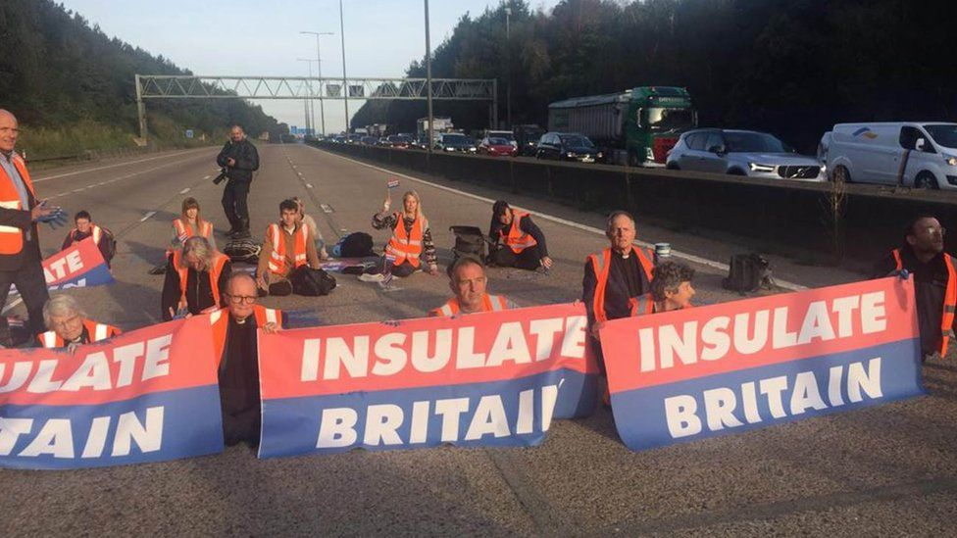


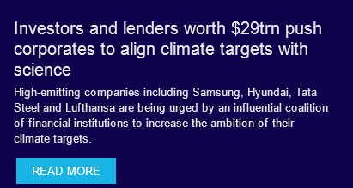
The Clamour grows louder from all parts of society

Slide 11
Sustainability – Many interpretations
            Many interpretations of sustainability
            Lots of talk but is there much communication?
              Damage to Arcadia - obliteration of ancient woodlands, tropical forests, badgers and orang utans
              Compliance: - environmental regulations re Pollution of air, water and soil
              Environmental management systems – e.g. ISO 14001 in 1996
              Market demands - Tendering and Procurement demands for low carbon solutions
              Investor concerns – introduction of IFRS standards
              Business strategy – costs and benefits; risks and opportunities.
              Which group do you think you belong to ?

Slide 12




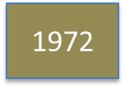
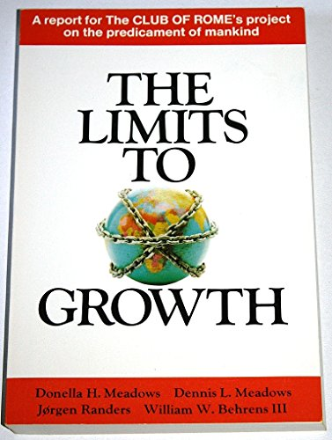

Sustainability is not a new concept
1972
1980
1988
1992
1985
2015

Slide 13
Key Themes of CPA Sustainability Policy work
          Exponential growth in the climate and sustainability agenda
          Decarbonisation and Net Zero
          Sustainability Measurement and Reporting
          Resource efficiency, waste reduction and towards a circular economy; including water
          Procurement Asks re Sustainability and Net Zero
          Innovation and Research support esp. for industrial decarbonisaton
          Biodiversity

Slide 14
The Hot Topic : Climate Change and Net Zero – everyone is talking about it
Massively, massively increased agenda on Net Zero - its necessary
Responding to the evident changes we are seeing
Concern has accelerated – with the global Extinction Rebellions of 2019 and the awareness across large parts of society of the need to do something - from government down to the individual.
COP 26 - added momentum in the UK as it was the host
UN, European, UK governmental actions moving down to regulations, public procurement requirements
Business engagement - these topics now reached the boardroom, the investor community, the client community, contractors, architects, procurers, surveyors
Not just climate concerns, energy costs huge amount of money for a manufacturer in process costs, offices and transport. Reducing energy costs is a win for businesses
Carbon reporting and decarbonisation plans needed from industry

Slide 15
UK Climate Policy Framework
UK Climate Change Act 2008, amended 2019 to Net Zero by 2050
Committee on Climate Change - Carbon Budgets and Annual appraisal of government performance
        Ten Point Plan for a Green Industrial Revolution
        Government Departments – Dept Energy Security and Net Zero (DESNZ)
        / DBT / DLUHC / Defra / Dept Transport / Treasury /
        Numerous Sector Decarbonisation Strategies
          Industrial Decarbonisation Strategy
          Heat in Buildings Strategy
          Transport Decarbonisiation Strategy
          Energy
          Hydrogen Strategy
        independent Chris Skidmore Report
        Numerous Parliamentary Committee reports
        The UK Emissions Trading Scheme
        What impact on your businesses?

Slide 16
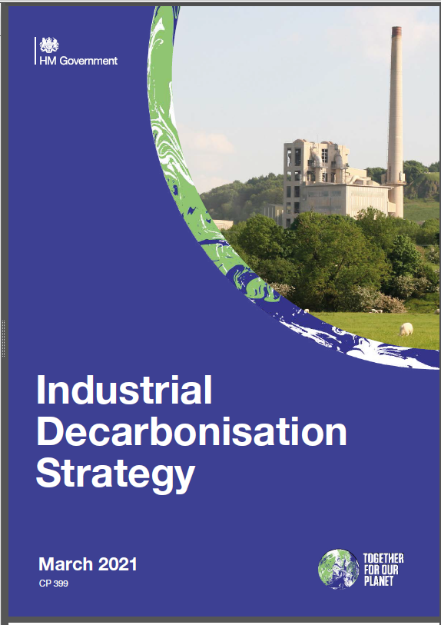
Manufacturing
        UK Industrial Decarbonisation Strategy, 2021
        Sets out how industry can decarbonise in line with Net Zero while remaining competitive and without pushing emissions overseas. Carbon Border Adjustment Mechanism / energy intensive industries
        UK ambition for decarbonising industry in line with net zero: need to reduce by at least two-thirds by 2035 and by at least 90% by 2050, via low carbon fuels, and with carbon captured through Carbon Capture, Usage and Storage
        Support increasing amounts of fuel switching to low carbon hydrogen during the 2020s
        Chapter 3 : Want to create the demand for “low carbon industrial products”
develop proposals for new product standards
develop proposals for product labelling
use public procurement to drive change
support businesses to make greener choices
Support increased resource efficiency by driving the transition towards a circular economy model and increasing reuse, repair and remanufacturing.
Independent Skidmore Report, 2022

Slide 17
Decarbonisation in Buildings and Infrastructure
            Part L revision / Future Homes and Buildings Standard - consultation expected / Future Homes Hub – industry consortium
            Push for Whole Life Carbon Assessment of new Buildings and Infrastructure; which for manufacturers means providing EPD information
            Heat in Buildings Strategy – still unclear how deliver 600,000 Heat Pump ambition; questionmark over hydrogen for homes. heat networks
            Retrofit Programme unresolved how to incentivise / finance private able to pay householder. Non govt National Retrofit Hub set up
            Numerous govt incentives that speed in and out on energy efficiency – Great British Insulation Scheme
            Infrastructure – lots of decarbonisation initiatives – PAS 2080 requirement coming / deliver of new low carbon energy infrastructure
            Construction Playbook – whole life carbon assessment required
            Carbon labelling of products – challenge for construction products which are intermediate products.
            Green Skills
            Large amount of research funding available – energy efficiency in manufacturing, opportunities of hydrogen, etc

Slide 18
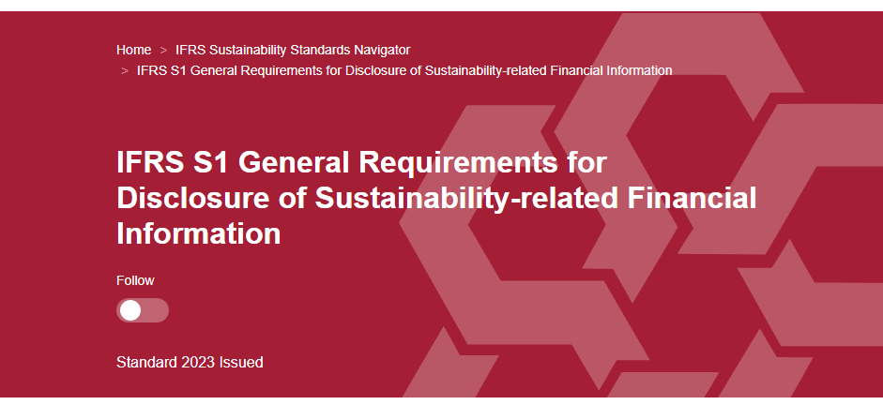
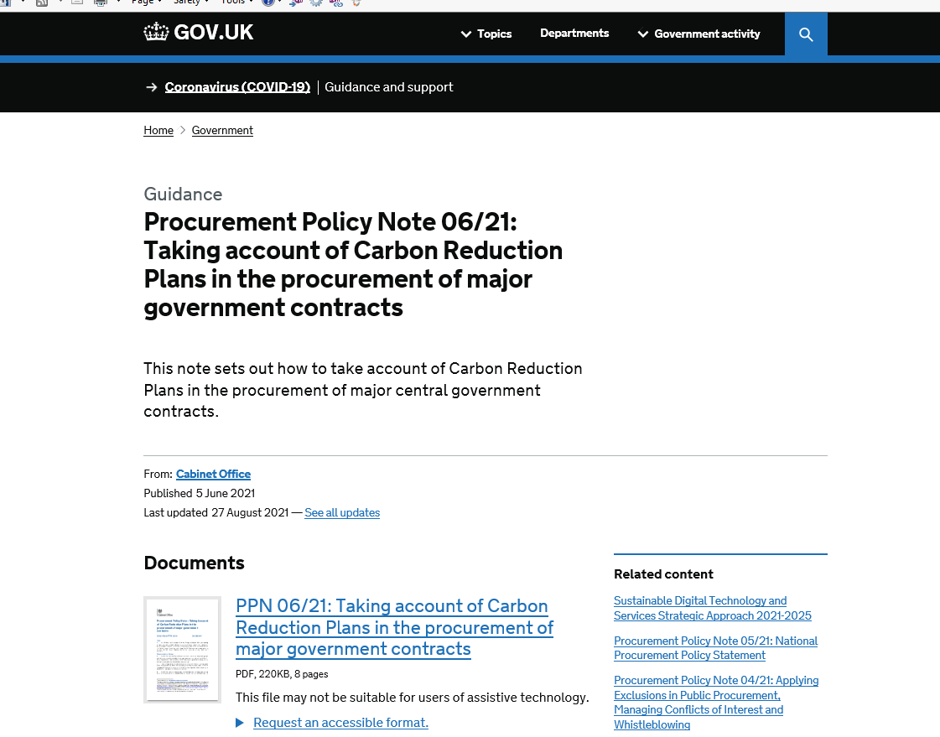
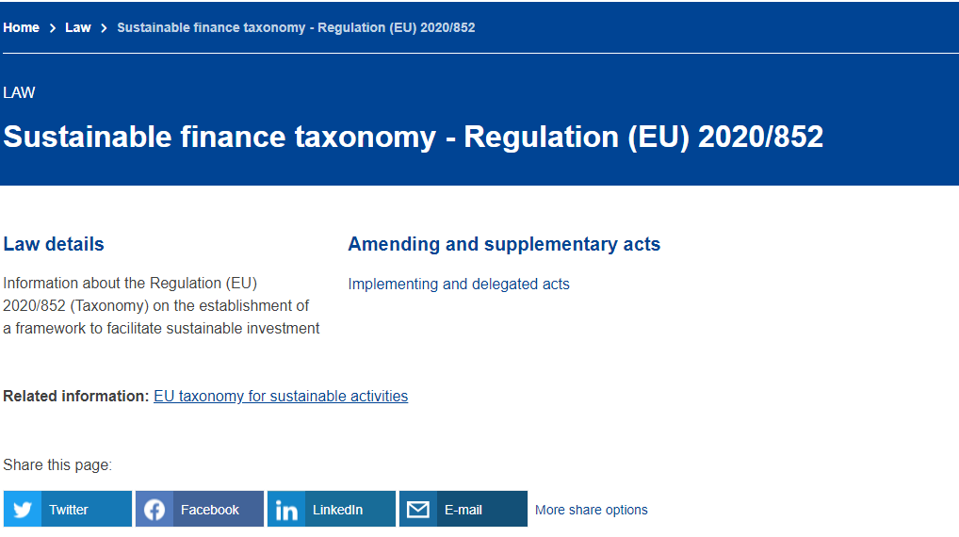
Investment and Procurement

Slide 19

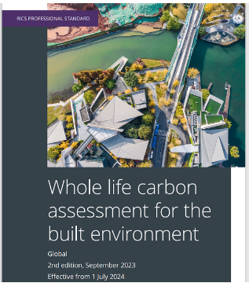
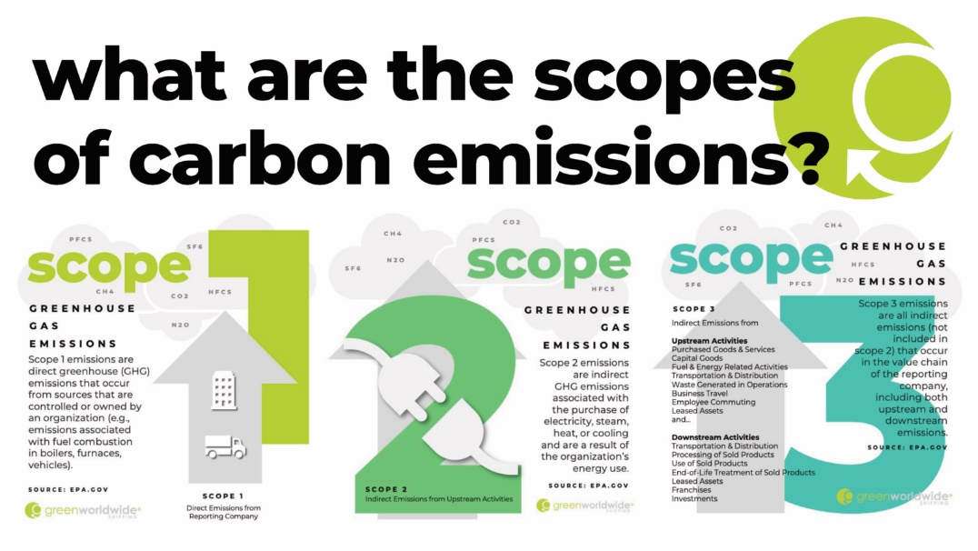
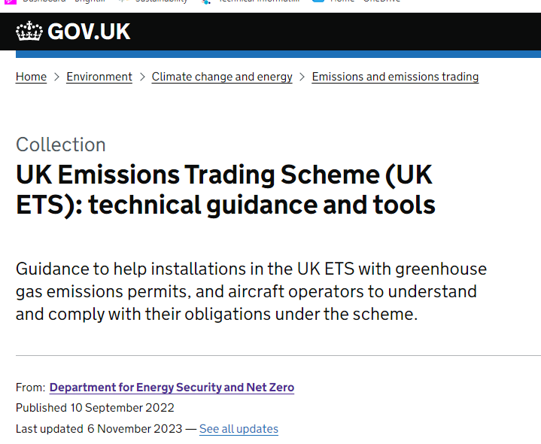
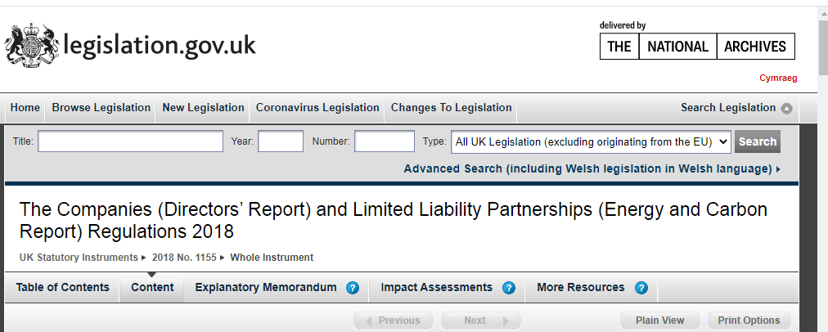

Sustainability Reporting

Slide 20
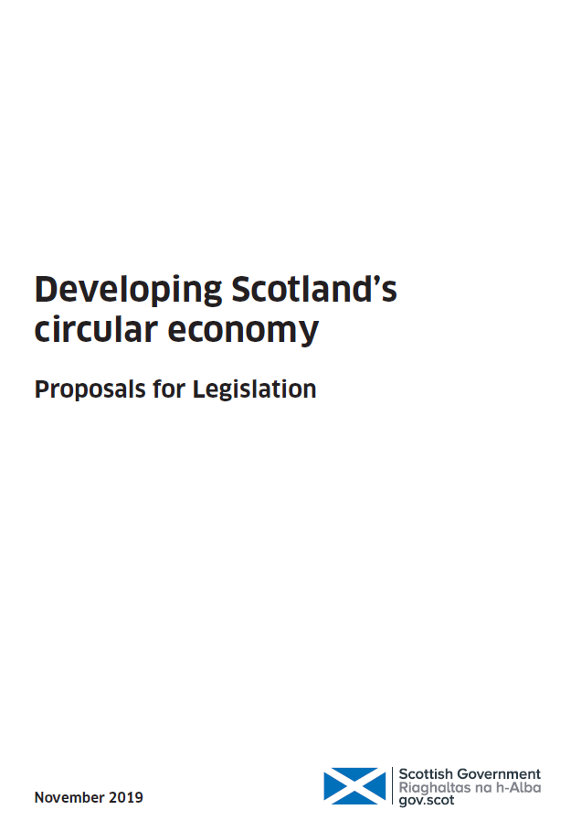


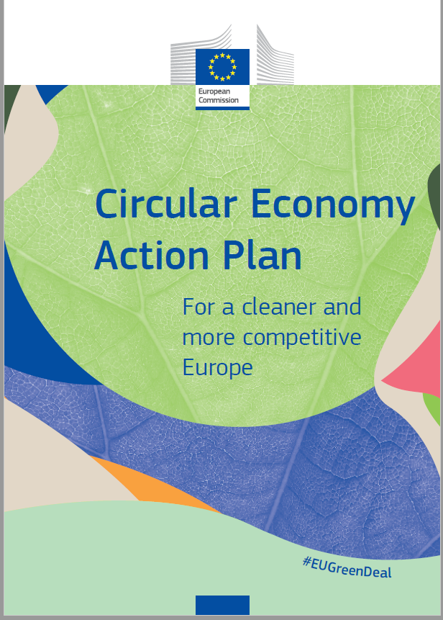
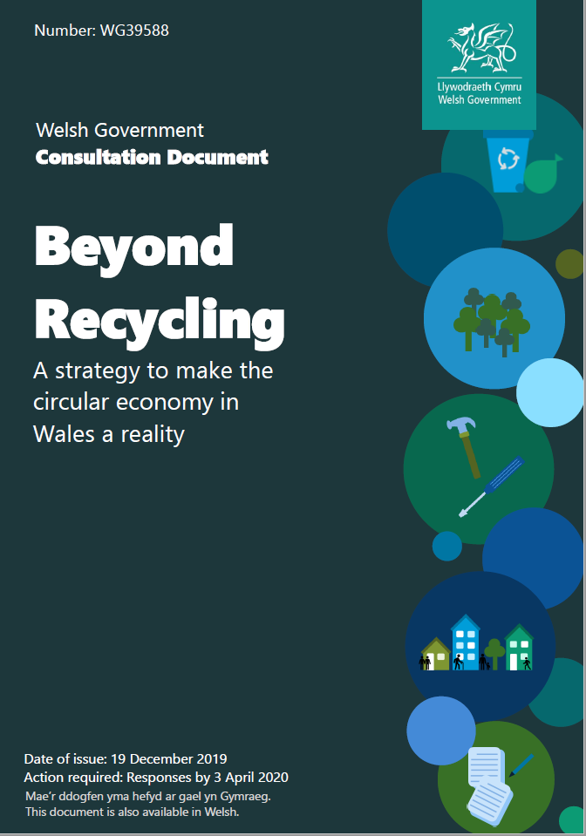
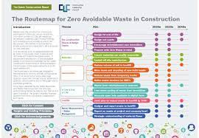
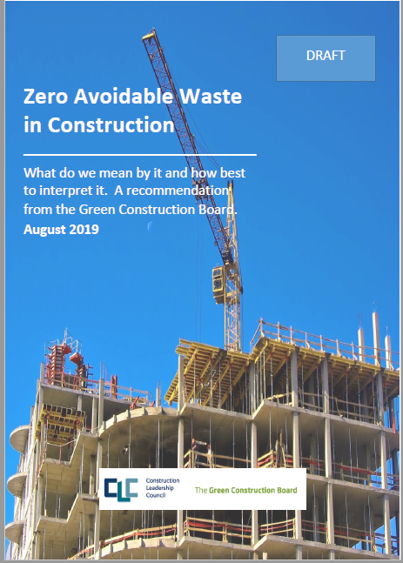
Resources, Waste & the Circular Economy

Slide 21
          My role as the CPA Sustainability Policy Advisor
          Making sense of the many sustainability policy and market initiatives - from UK - and Europe
          Provide an early warning system to members on the thinking emerging from government on sustainability topics; what direction policies are heading, what is likely to impact them - forecasting role.
          Inform members of Calls for Evidence, consultations, research projects; collate and discuss an industry position
          Provide that voice of the construction products sector back to government
          Participate in Standards development – BSI, and liaise with Construction Products Europe
          Keep members briefed on market initiatives, research projects and innovation opportunities
          Engage with the wider construction community, professional bodies and academia – as time allows !
          Produce Briefing Papers and signposting to what manufacturers are doing on Net Zero via Decarbonisation Directory
          Green Construction Board - Support to the Chair and act as joint secretariat with Dept of Business and Trade – GCB provides Thought Leadership on Sustainability and Net Zero to government and CLC
            A community of sustainability professionals

Slide 22
CPA Sustainability Policy Group
          CPA sustainability workstream has existed for 20 years
          CPA Sustainability Policy Group has over 200 members participating - companies and Trade Assoc.
          Different CPA members interested in different themes and topics
          CPA members are at different stages in their sustainability journey – beginner, intermediate and advanced
          Sustainability agenda massively increased in recent years - not just regulation but market forces
          Our Group meets regularly – now online - on a whole range of topics – and at different knowledge levels
          Subgroups set up as necessary e.g Packaging and EPR; SMEs
          Briefing Papers, Decarbonisation Directory – on website
            A community of sustainability professionals

Slide 23
CPA Sustainability Policy - current issues
  Untangle confusion between company carbon reporting - Scopes 1,2 3 compared to product LCA and asset WLCA carbon reporting
  Feed into the many government projects on carbon accounting – Scope 3, IFRS standards and CBAM
  Carbon labelling of products – questioning whether it is suitable for intermediate products such as construction products
  Client and contractor demand for Whole Life Carbon Accounting (WLCA) is increasing – implications for EPD information
Constant drive to ensure there is a better understanding about EPD amongst the wider construction industry – Briefing Papers
Industrial Decarbonisation – the need for a robust and long term industrial strategy from government in supporting the transition to clean energy, especially for the energy intensive industries
Packaging and the Extended Producer Responsibility – seeking clarity on detail / lobbying over household waste definition
Resource efficiency + Circular Economy – increasing discussion about reuse, remanufacture, take back schemes, material passports
Inclusion of various EPD indicators in the Declaration of Performance in the revised EU Construction Products Regulation
Digitalisation of environmental product data
Ensure Procurement Asks on Net Zero and other Sustainability indicators are based on robust understanding of concepts, standards and measurement.
SMEs – how to help them negotiate a baffling array of sustainability advice and identify the business benefits
Signpost to the work manufacturers – whether companies or trade associations– are doing to decarbonise – CPA Decarbonisation Directory

Slide 24
What are you doing on Net Zero and Sustainability
What is your contribution to solving the problem
Do you have a decarbonisation plan?
Are you measuring and reporting your carbon ?
Have you set a carbon reduction target?
Do you have a strategy to decarbonise your transport?
Are you looking at how climate changes will impact your business and the relevance of your offering
What about reuse, recycling, take back – are these relevant to you? Water
What about packaging? Will EPR increase your costs.
All these measures will be different, will have different emphases depending on your sector and businesses.
By measuring and reporting can you identify cost reductions, identify contract opportunities, attract new staff, keep employees longer etc
What are the stories you can tell from a company perspective as how your product helps the built environment to decarbonise.
BUT NO GREENWASHING

Slide 25
        Sustainability
        Now a strategic issue for businesses
        Risks, Opportunities and Resilience

Slide 26

Thank You
Jane.Thornback@constructionproducts.org.uk
www.constructionproducts.org.uk

